Slide 1
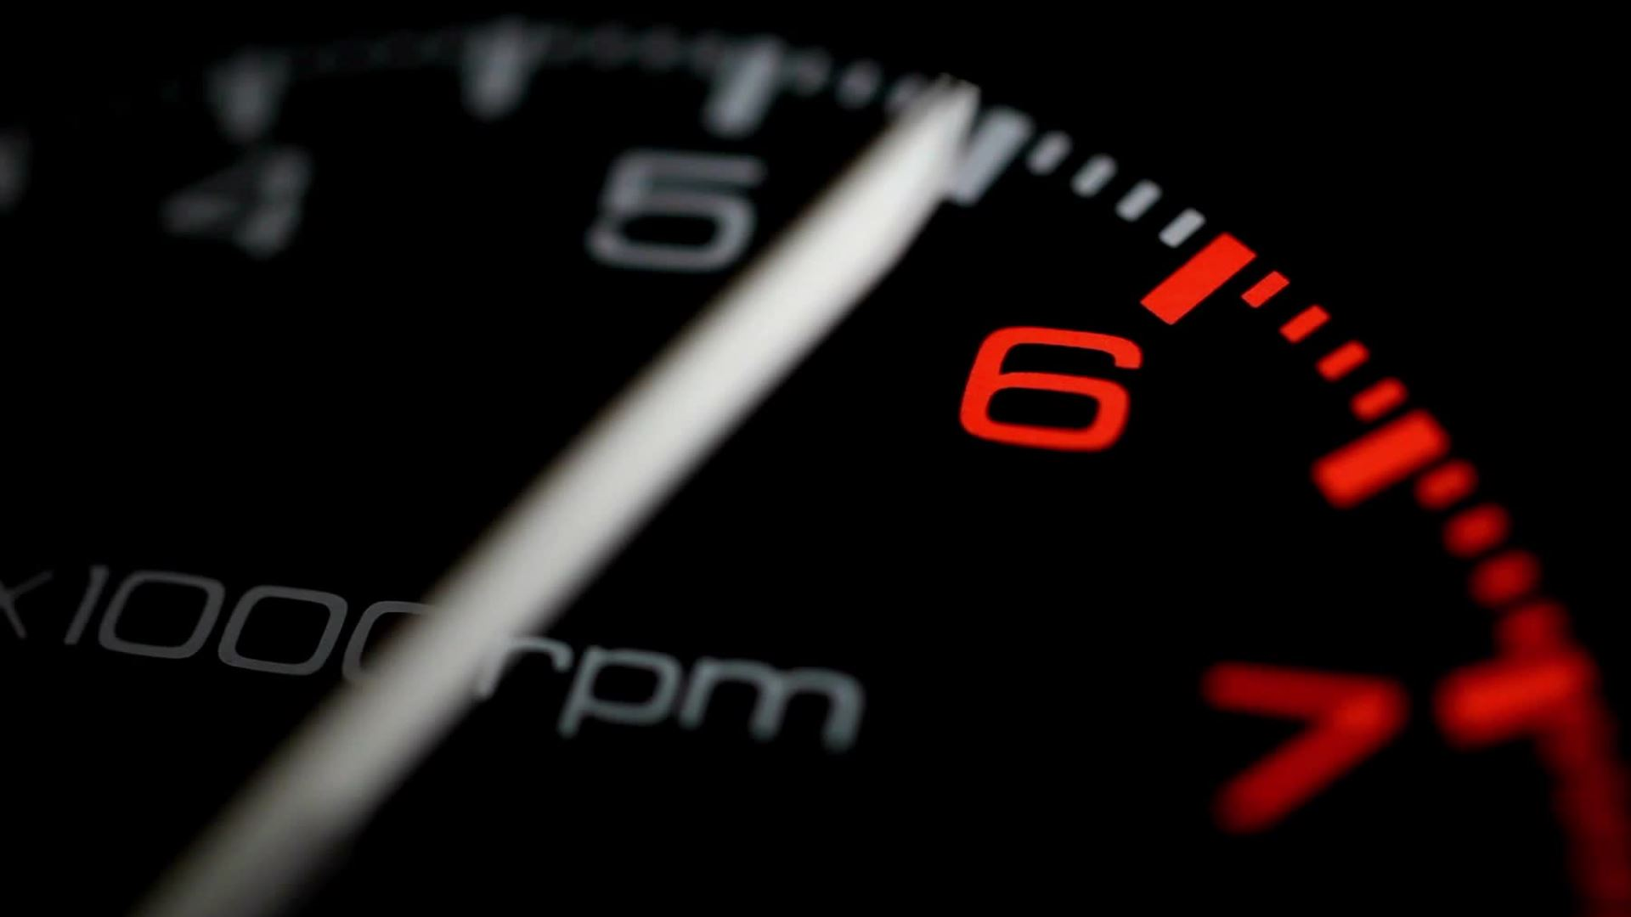
Real Time Driver Drowsiness Detection Based on Deep Learning
Presented By – Shreyansh Gupta
Supervisor : Abid Yaqoob

Slide 2
Introduction
Driver drowsiness is a major cause of road accidents and fatalities globally
Aims to develop a real-time system to detect driver drowsiness using deep learning and computer vision techniques

Slide 3

Problem Statement
Need for an affordable and globally applicable drowsiness detection system for diverse vehicles and environments.
Focus on using behavioral signals like eye movements to identify fatigue.

Slide 4
Related work
CNN-based approaches show promise for real-time detection with high accuracy, but need more diverse training data
Haar Cascade / Real-time approaches effective but can be impacted by lighting, camera angle, blink patterns
Our Approach:
Leverages comprehensive eye state dataset
Robust preprocessing for varying conditions
InceptionV3 CNN for improved feature extraction
Aims to advance real-time detection across scenarios

Slide 5
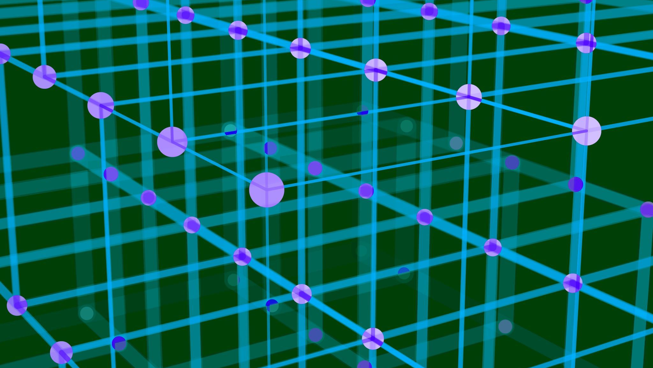
Methodology
Used CRISP-DM framework as a guiding methodology
Key phases: data gathering, data preparation, modeling, evaluation
Employed MRL eye dataset containing open/closed eyes images

Slide 6
Model Development
Used Convolutional Neural Networks (CNNs) and transfer learning
Base model: Pre-trained InceptionV3 CNN architecture
Custom layers added on top for eye state classification

Slide 7

Key Results
Models achieved training accuracy between 91.67% to 95.04%
Validation and test accuracy ranged from 83.74% to 92.60%
Real-time testing showed promising detection capability

Slide 8

Real Time Detection

Slide 9

Conclusions
Models showed good performance but constraints in generalization ability
Further research needed to enhance model reliability for practical usage
Potential for commercialization in driver assistance systems

Slide 10

Future Work
- Comprehensive hyperparameter tuning for improved performance
- Explore more advanced neural network architectures
- Additional regularization techniques to enhance generalization
- Validate model on more diverse and real-world datasets
- Deploy system on embedded platforms for integration into vehicles

